Slide 1
Aviation Partner Relationship Building
Roger Martin
National Weather Service
Wichita, KS
roger.martin@noaa.gov
Jason Anglin
National Weather Service
Great Falls, MT
jason.anglin@noaa.gov
National Weather Service · Great Falls, Montana

Slide 2
Aviation Partner Relationship Building
NWS Great Falls Efforts
What We Have Learned
Airport Weather Warnings
Partnership Example
National Weather Service · Great Falls, Montana

Slide 3
August 9th 2016 – Detailed Timeline
The Following Takes Place
Between 505 PM and 715 PM on August 9th 2016

Slide 4
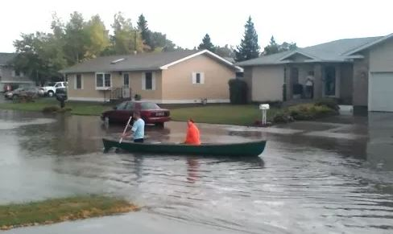
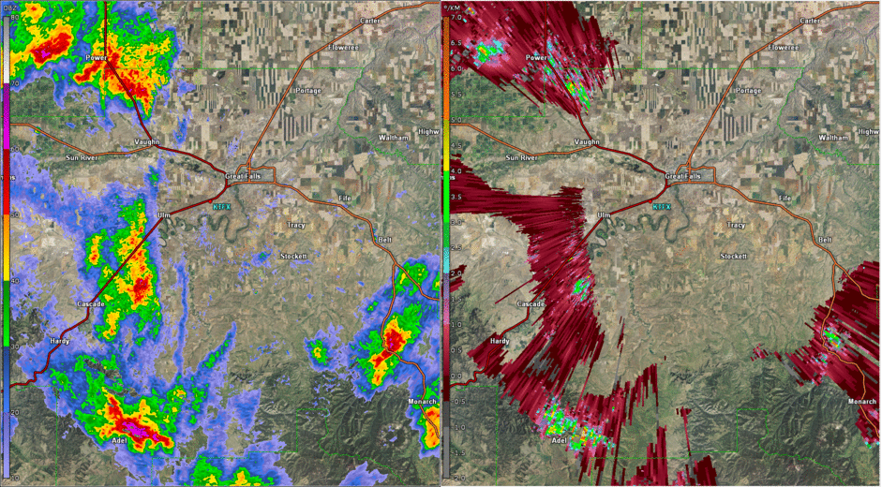
August 9th 2016 – Flash Flooding Event
0505 PM - Forecaster 1 continues to issue warnings. Forecaster 2 had a weather break to launch the balloon, however, was not given permission by Great Falls Air Traffic Control (ATC)
0515 PM - Operations are starting to ramp up
0520 PM - A strengthening storm approaches Great Falls from the SW. At the same time, storms begin developing in the higher terrain south of Great Falls. Due to lightning the window to launch the balloon has now filled in
National Weather Service · Great Falls, Montana

Slide 5
August 9th 2016 – Flash Flooding Event
0540 PM – The storm reaches the WFO Great Falls office with heavy rain and strong wind gusts in excess of 50 mph. Much of the new developing storm was in so called “Cone of Silence” being directly overhead. Some sampling errors probably introduced before storm hits the city.
0600 PM – The storm begins to move over the heart of Great Falls. Meanwhile Forecaster 1 continues to issue warnings. Everything was still going well at this point. The balloon was likely going to be late. Lead recommends to Forecaster 2 to make the National Center for Environmental Prediction (NCEP) aware. NCEP is alright with the delay.
0617 PM – Off-duty NWS employee texts one of the forecasters on duty (Forecaster 2) letting him know of some street flooding around his house
0630 PM – A strong storm from the south begins merging with the storm over Great Falls.
National Weather Service · Great Falls, Montana

Slide 6
August 9th 2016 – Flash Flooding Event
0631 PM – Forecaster 2 calls off-duty Employee to follow up on his text. The employee mentions the flooding probably warrants at least an urban and small stream advisory
0641 PM – Forecaster 2 and Lead/IC briefly discuss the conversation with off-duty employee and decide to put out an Urban and Small Stream Flood Advisory (FLS). The FLS is issued through 7:30pm. Meanwhile, Forecaster 1 continues to issue warnings, and is keeping up with all storms
0642 PM – The internet in the office goes out for about three to five minutes, limiting messaging of the event to the office iPad
National Weather Service · Great Falls, Montana

Slide 7
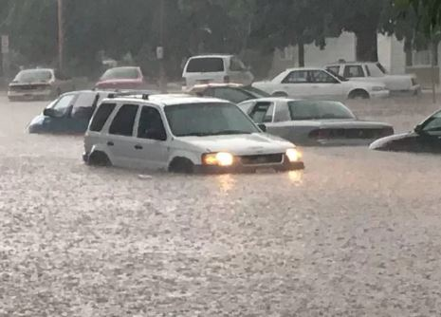
August 9th 2016 – Flash Flooding Event
0645 PM – Calls begin coming in from the public, spotters, and NWS employees of significant flooding in town, including cars stranded and road impassable. Media chats in NWSChat of similar reports.
0650 PM – After a brief discussion, Lead and Forecaster 2 decide to go with a Flash Flood Warning for Great Falls, in effect through 8:45pm. Forecaster 1 continues to keep up with warnings.
0700 PM – Balloon finally launched. NCEP was kept informed, and approved the late launch.
0715 PM – Operations begin to settle down.
Echo Chavez
National Weather Service · Great Falls, Montana

Slide 8
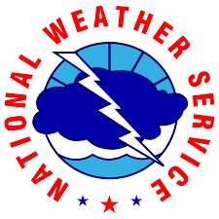
August 9th 2016 – Flash Flooding Event
Lesson Learned: Limited in response when ATC tells you to hold. Instead we focused efforts on building up the partnership with the FAA tower, and do an in person partner meeting to further explain how we can help each other out.
National Weather Service · Great Falls, Montana

Slide 9
Relationship Building
Met with Great Falls ATC Tower Management
Had great discussion on NWS Products, services, and partnership
FAA gave us a tour of facilities, operations, and tower
National Weather Service · Great Falls, Montana
Notes:
Need better pictures

Slide 10
Relationship Building
Discovered NWS Airport Weather Warnings were not being received by tower controllers
Tower controllers had a wide range of backgrounds, and there was a need for an NWS tour, general meteorology knowledge, safety tips, and TAF refresh
Upper-Level Jet Stream
National Weather Service · Great Falls, Montana
Notes:
Need better pictures

Slide 11
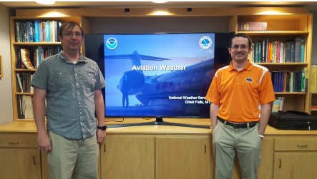
Relationship Building
Discussed methods for the balloon launch
Controllers would like a heads up on certain significant weather (freezing rain, severe thunderstorms, winds over 70 kts)
Most were unaware of PROB30 in a TAF
National Weather Service · Great Falls, Montana
Notes:
Need better pictures

Slide 12
Relationship Building
Most liked the tour
Be aware of using Flight Aware for situational awareness as not all flights show up
Wind Rose Graphics were very popular
Most only looked at the TAF through their operational work shift
National Weather Service · Great Falls, Montana
Notes:
Need better pictures

Slide 13
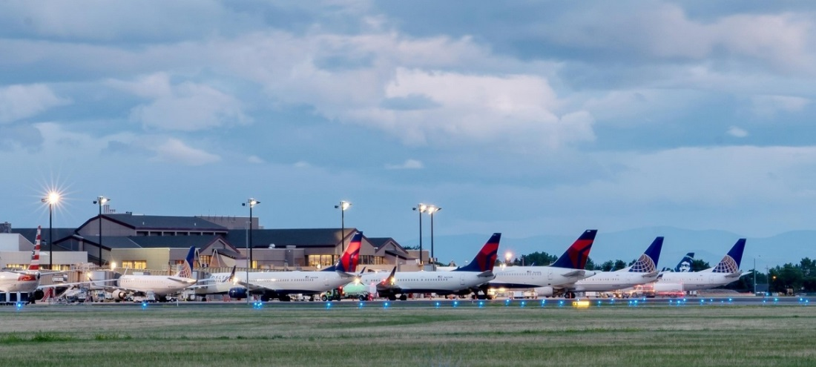
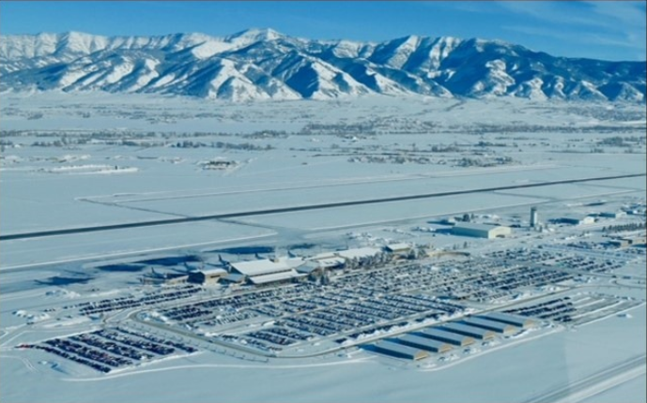
Airport Manager Meetings
Learn about Airport Weather Warnings
Learn about their operations, strengths, and their vulnerabilities
Image courtesy Bozeman Yellowstone International Airport
National Weather Service · Great Falls, Montana

Slide 14
Airport Manager Meetings
Freezing rain is a huge impact to airport ground operations
New FAA rules require almost any measurable snow to be plowed
Light/moderate snow versus heavy snow can impact icing operations
Image courtesy Helena Regional Airport
National Weather Service · Great Falls, Montana

Slide 15
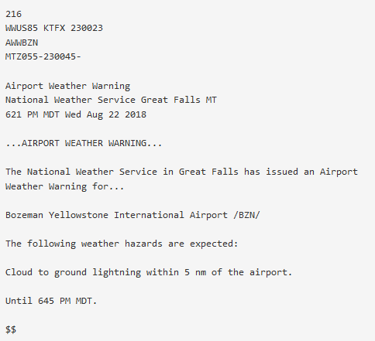
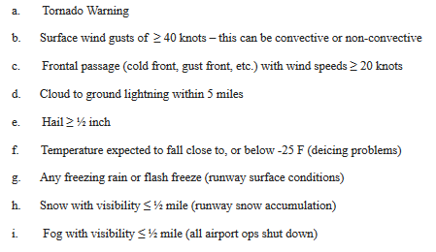
Airport Manager Meetings
Some just prefer a heads-up email leading up to an event, then a phone call for imminent weather instead of an Airport Weather Warning
Bozeman wanted to add the Airport Weather Warning
National Weather Service · Great Falls, Montana
Notes:
Put in airport weather warning criteria for bozeman

Slide 16
Relationship Building – Helena Example
What Happened?
Visibility sensor went out during the early-morning hours of Christmas Eve
United Airlines flight (already delayed out of Denver) had to turn around mid-flight because VIS was out and tower was closed
Passengers told it was faulty airport equipment ➔airport manager had to field very difficult phone calls
National Weather Service · Great Falls, Montana

Slide 17
Relationship Building – Helena Example
What Followed?
Follow-up communication via email, phone, and in-person with airport manager (included Western Region, MIC, WCM, ESA, and both Aviation Program leaders)
All three forms of communication important
Researched ways the NWS could possibly help alleviate future issues
No guarantees, but promise to do our best
Relationship strengthened
National Weather Service · Great Falls, Montana

Slide 18
Aviation Partner Relationship Building
Questions?
Roger Martin
National Weather Service
Wichita, KS
roger.martin@noaa.gov
Jason Anglin
National Weather Service
Great Falls, MT
jason.anglin@noaa.gov
National Weather Service · Great Falls, Montana

